Slide 1
Team TBD
Patrick Bargoud
Corey Rejaud
Kevin Horlavadi

Slide 2
Project Description
Rutgers NextBus
User enters in his/her schedule
Title, Weekday, Start Time, End Time, Campus
App will notify user 40 minutes before class begins
App will take user’s location and determine the campus of user’s next class
App will then display bus times of appropriate bus based on campus information

Slide 3
Programming goals/challenges
NextBus API
Implementing the alarm
Notifications
Get user location

Slide 4
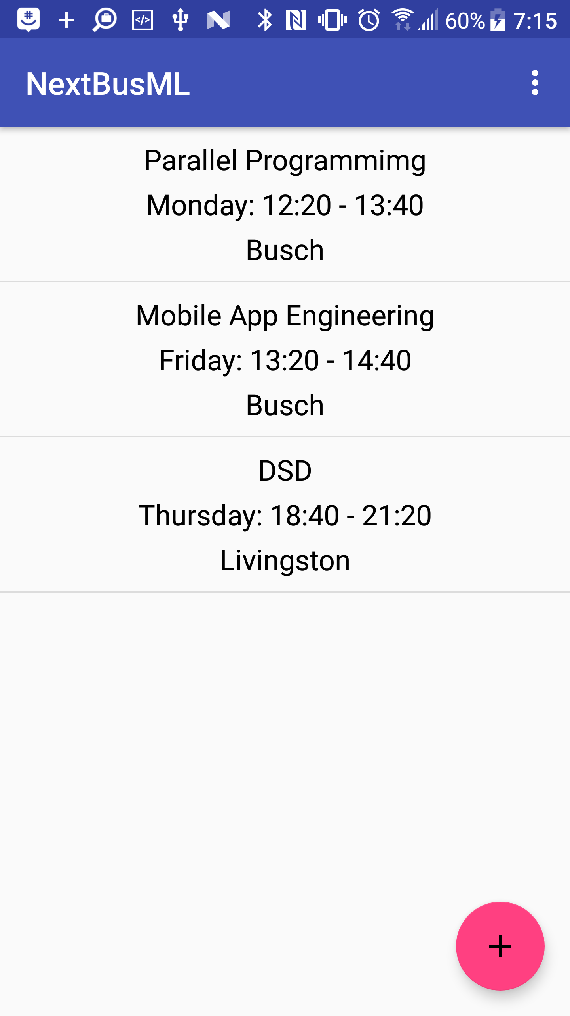
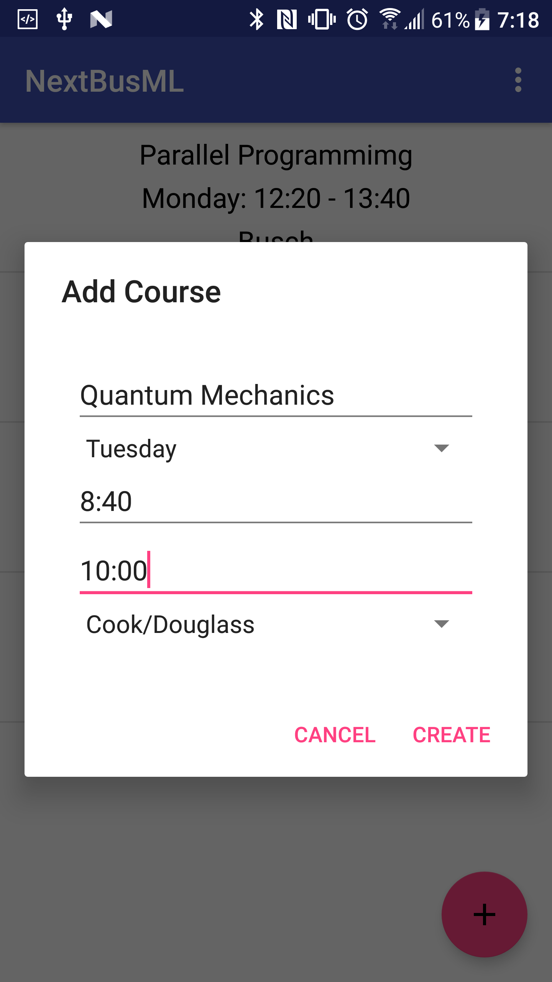
Course Schedule

Slide 5
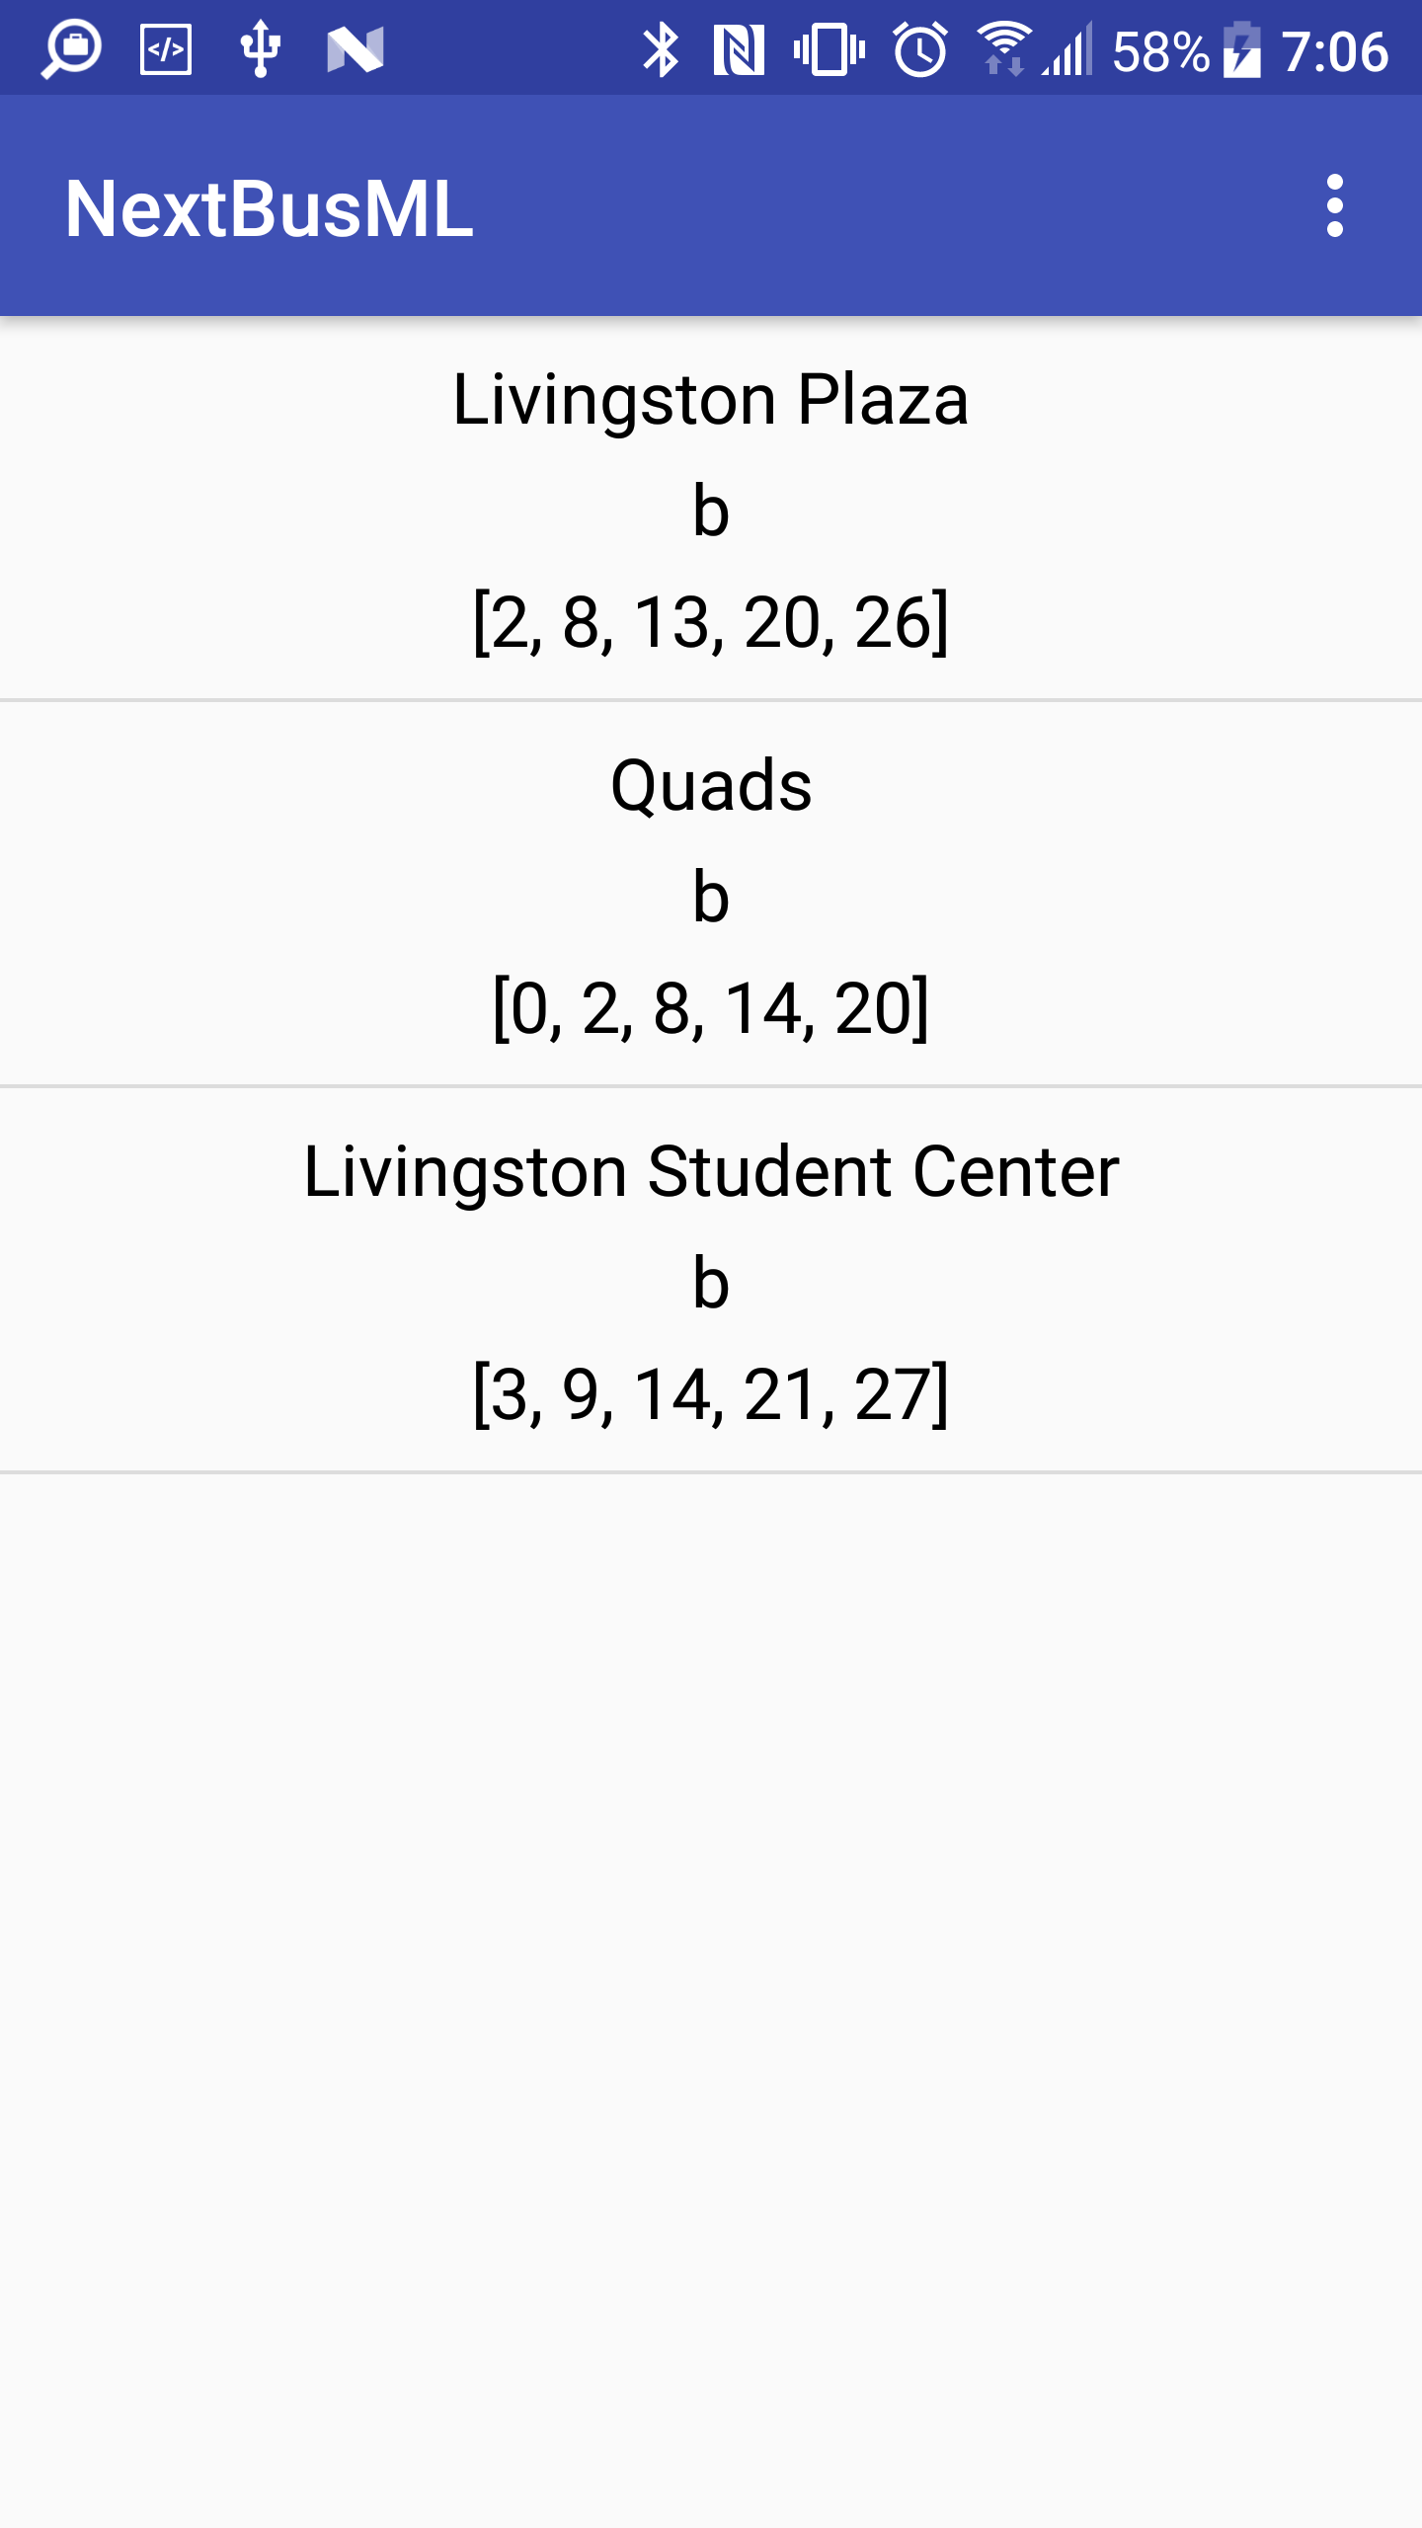
NextBus List

Slide 6
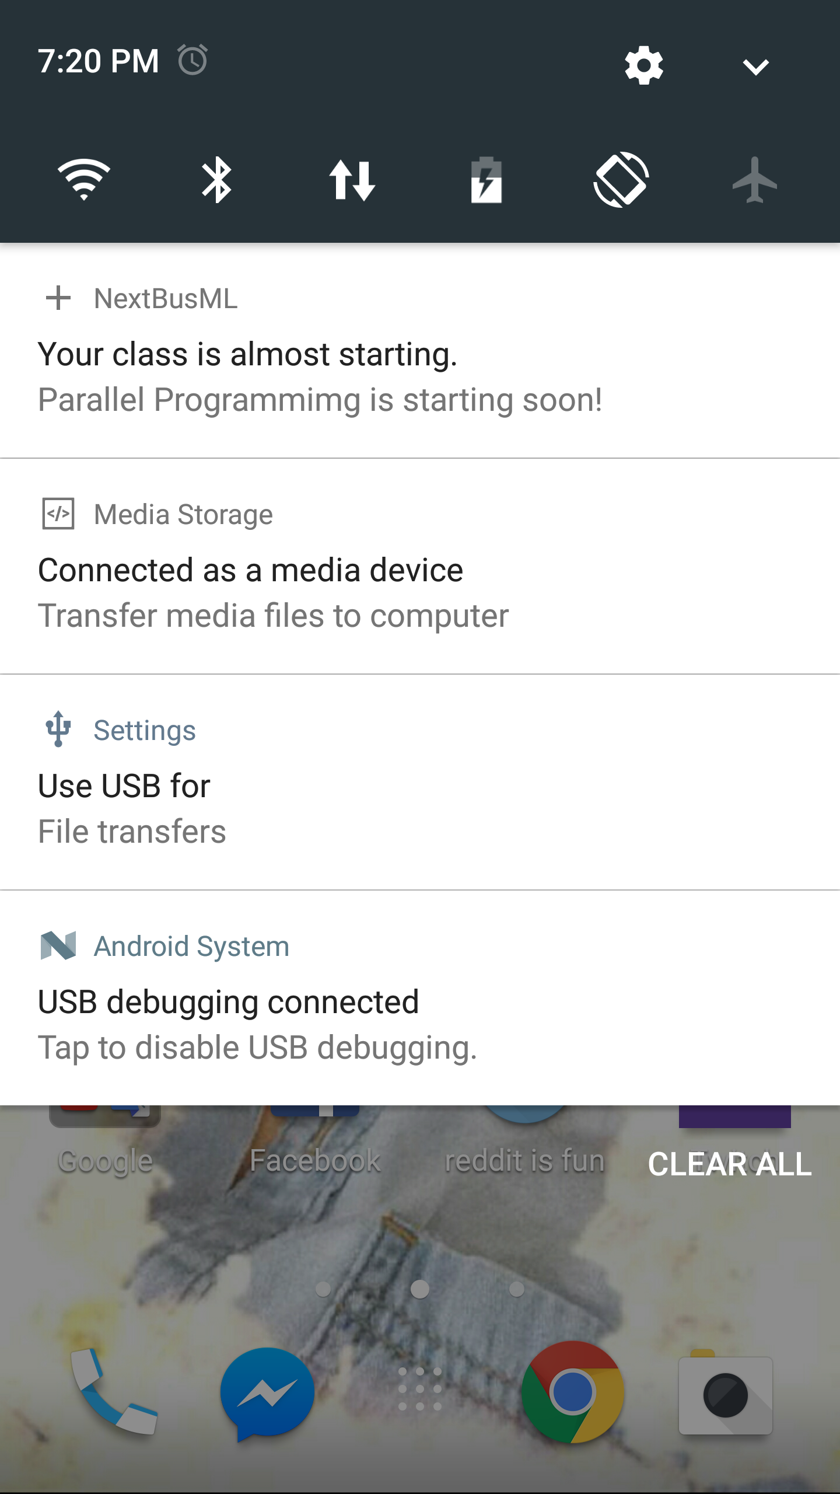
Notification

